Slide 1



Predicting Credit Card Approvals Using Logistic Regression.
Team - 06

Slide 2





Team Members
Mamatha Thippani
Data Research & Analysis
Priyanka Kalyani Data Engineer
Inturi Manasa
Data Visualization
Amer Sohail Shaik
Modelling and Deployment

Slide 3

Introduction
This presentation explores the process of predicting credit card approvals using logistic regression. We'll cover the data collection, preprocessing, modeling, and evaluation steps involved in creating a predictive model.

Slide 4
Proposed Solution
Start with a clear question
Determine predictability
Data preprocessing
Explore and visualize the data
Choose an appropriate forecasting model
Train and validate the model
Forecast future values
Evaluate and refine the results

Slide 5
Methodology:
Make data sequence by considering sequence length 15
Data collection
Data processing
Data splitting into train and test: 80:20
Train the models
Test the models
Calculate the model metrics

Slide 6

Data Sources
Utilizes credit card application data.
Focuses on attributes significant for predicting approval outcomes.
Analyzes various factors.
Factors include credit history, income, and employment status.
Other Data Sources
GitHub
Climate Data Online (CDO)
Kaggle

Slide 7
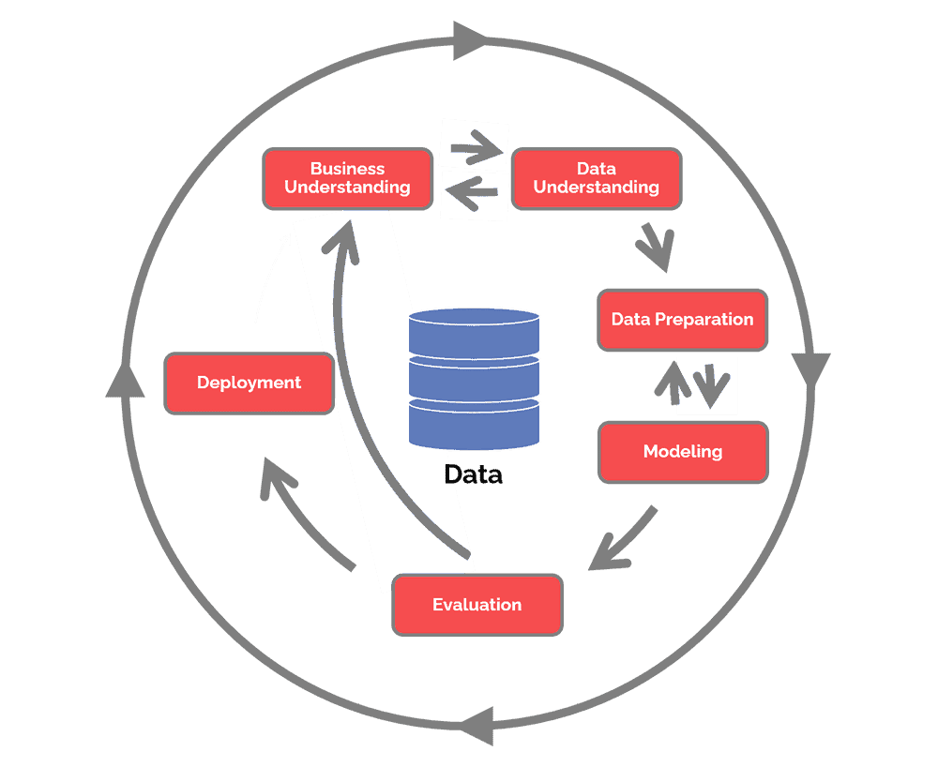
CRISP DM - METHODOLOGY
Business understanding – What does the business need?
Data understanding – What data do we have / need? Is it clean?
Data preparation – How do we organize the data for modeling?
Modeling – What modeling techniques should we apply?
Evaluation – Which model best meets the business objectives?
Deployment – How do stakeholders access the results?

Slide 8
Tools Used
Python Libraries:
Pandas
NumPy()
Stats models
Scikit-learn
Other Tools:
R Packages:
MATLAB
SAS

Slide 9


Thank you

